Slide 1

Ramjet Flow Rate for Power Optimization
By: Deborah Perez, Kainen Shaw, Nathan Klotzle, and Kurt Trocino

Slide 2
01
02
TABLE OF CONTENTS
03
04
Problem Definition and Objectives
Background and Methodology
Formulas and MATLAB Code
Data and Data Aggregation

Slide 3
Problem Definition and Objectives
Problem Definition:
The performance of a ramjet missile is highly dependent on operational parameters such as altitude and speed. To properly analyze and optimize the ramjet's efficiency, thrust, and mass flow characteristics, it is critical to start from a feasible baseline without the need for additional propulsion systems.
Objectives:
Understanding its operation through the Brayton thermodynamic cycle.
Calculating thrust using established NASA, MATLAB, and textbook equations.
Determining optimal altitude and speed based on thrust and efficiency analysis.

Slide 4
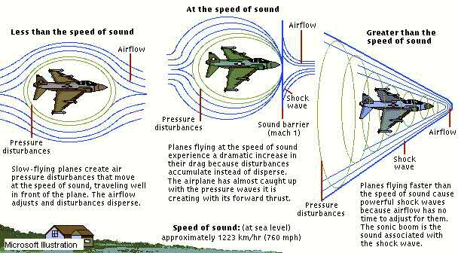
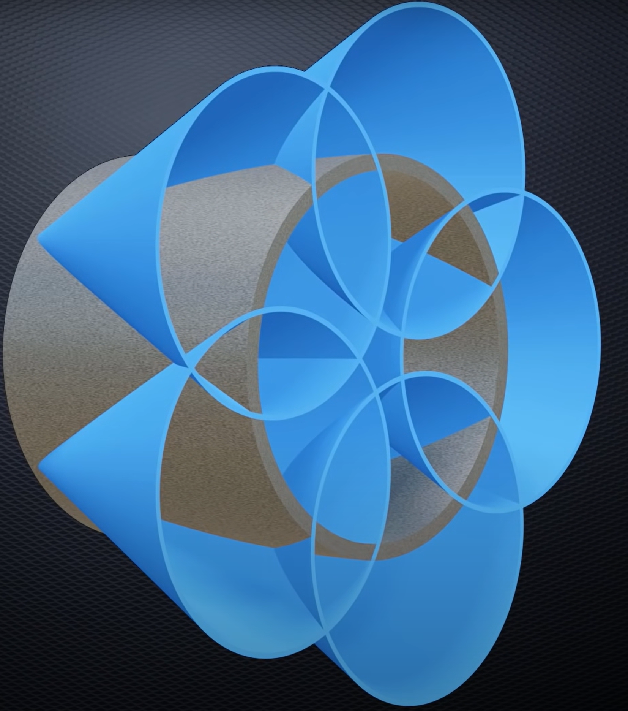
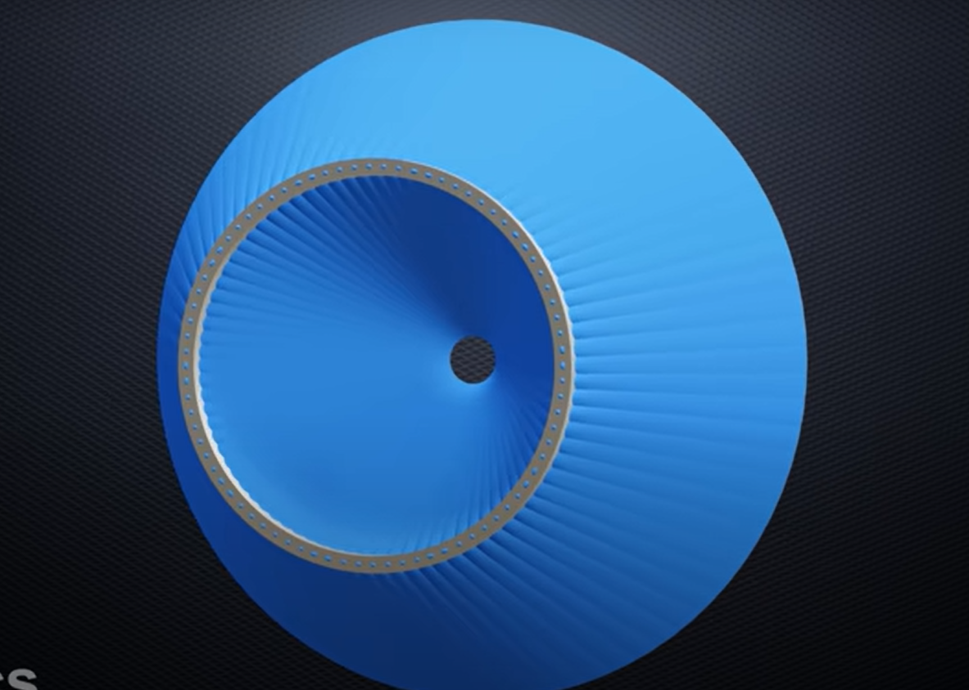
Background
A ramjet is a type of engine that uses the ram effect to create thrust instead of a compressor
Ram effect - where the Conical nature of shockwaves around a cylindrical volume form a nexus compression point

Slide 5
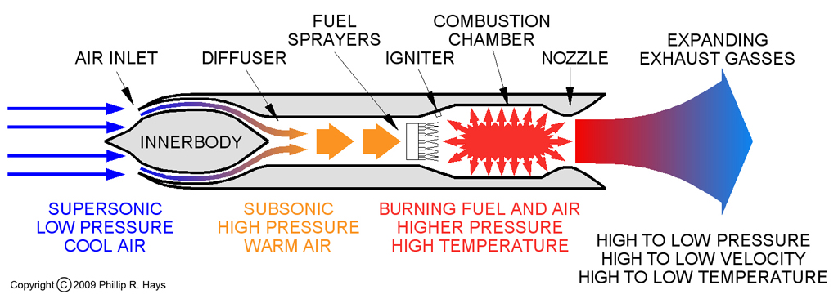
Background

Slide 6
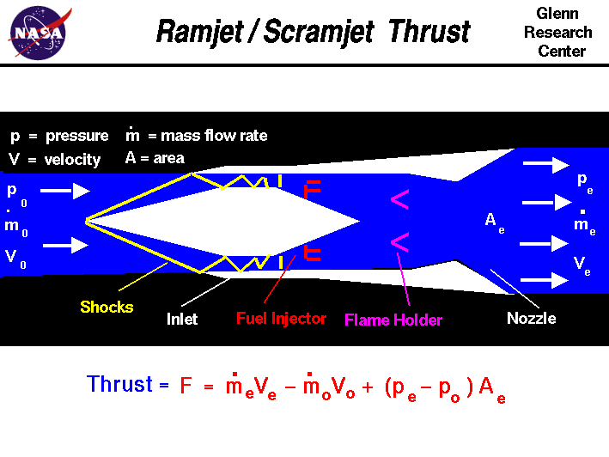
Background

Slide 7
Methodology
Theoretical framework:
Review the principles of ramjet operation and the Brayton thermodynamic cycle.
Use equations from NASA, MATLAB, textbooks, and USU resources to model ramjet performance.
Baseline Setup
Initiate analysis for constants for the range of mach 2 to 4, ensuring no booster required
Gradually vary altitude and speed to observe performance changes.
Simulation Tools:
Perform calculations and visualizations using MATLAB and related computational tools.

Slide 8
Formulas and Parameters
Ramjet Dimensions
Ramjet Flight
Ramjet inlet area = 0.1 m^2
Ramjet outlet area = 0.01 m^2
Ramjet fuel: JP-7
Altitude Range: 3000 m - 25000 m
Sea Level Temperature:
15 degrees Celsius
Sea Level Pressure:
101.33 kPa
Air Fuel Ratio:
14
Ramjet Velocities
Input Velocities:
650 m/s (mach 2) up to 1250 m/s (mach 4)

Slide 9
Equations Cont.
Ambient Pressure
beta = 0.000650; %K/m
P_1 = P_sea*((1-((beta*altitude)/T_sea))^(9.81/(R*1000*beta)));
Inlet Temperature
T_1 = T_sea - (6.5 * (altitude/1000));
Specific Heat with Constant Pressure
C_p = 1.007 + 0.000064.*T_1 - 0.0000004*T_1^2 + 0.000000001*T_1^3;
Inlet Mach
speedofsound = sqrt(gamma_p * R * T_1 * 1000);
M_1 = airplane_speed/speedofsound;
Gamma
Gamma = C_p / (C_p - R)
Inlet Pressure
P_2 = P_ambient*((1+((gamma-1)/2)*M_1^2)^(gamma/(gamma-1)));
Stagnation Temperature
T_stag = T_1 * (1 + (((gamma - 1)*0.5)*M_1^2)); %K

Slide 10
Equations Cont.
Reference Stagnation Temperature / Outlet Temperature
T_stag_ref = temperature_stagnation_reference(T_stag, eta, FAR, heating_value, C_p, T_1); %K
M Dot Air
m_dot_1_air = m_dot_inlet(rho_1, inlet_area, vehicle_speed(i)); %kg/s
M Dot Fuel
m_dot_1_fuel = m_dot_1_air * FAR; %kg/s
M Dot Out
m_dot_2 = m_dot_1_air + m_dot_1_fuel; %kg/s
Outlet Velocity
vel_2 = sqrt(2000*heating_value*FAR+(vehicle_speed^2)*eta);
Thrust
thrust = (m_dot_2 * vel_2 * 0.001) - (m_dot_1_air * airplane_speed * 0.001) + ((P_2 - P_1) * outlet_area);

Slide 11
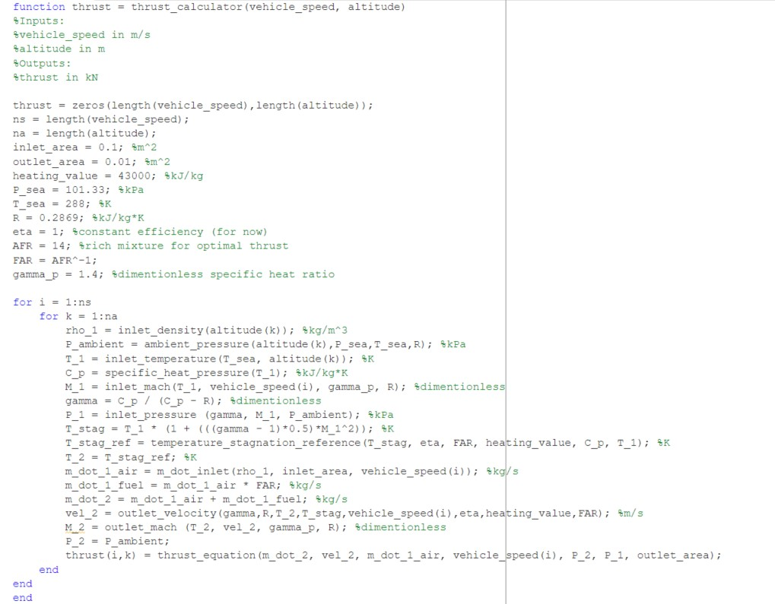
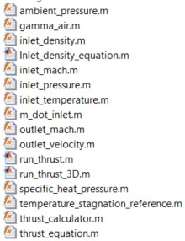
MATLAB Code

Slide 12
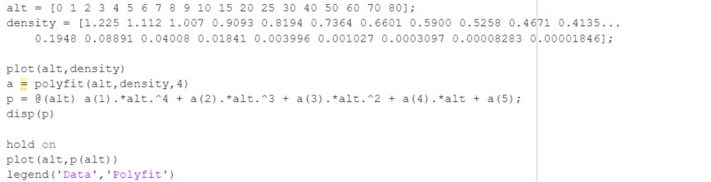
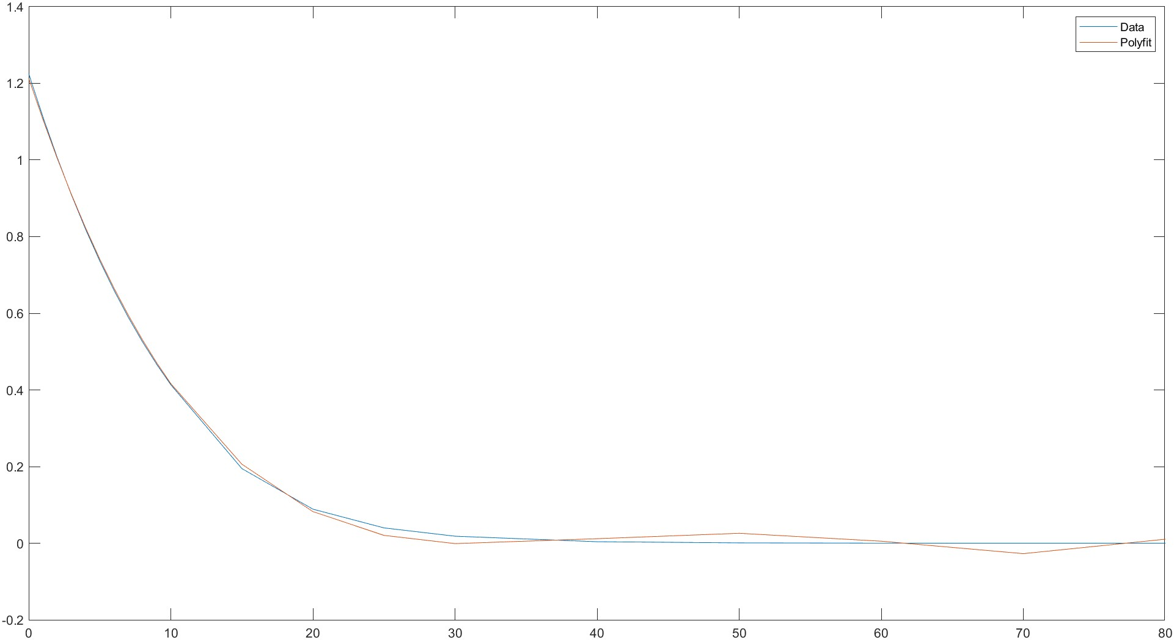
MATLAB Code

Slide 13
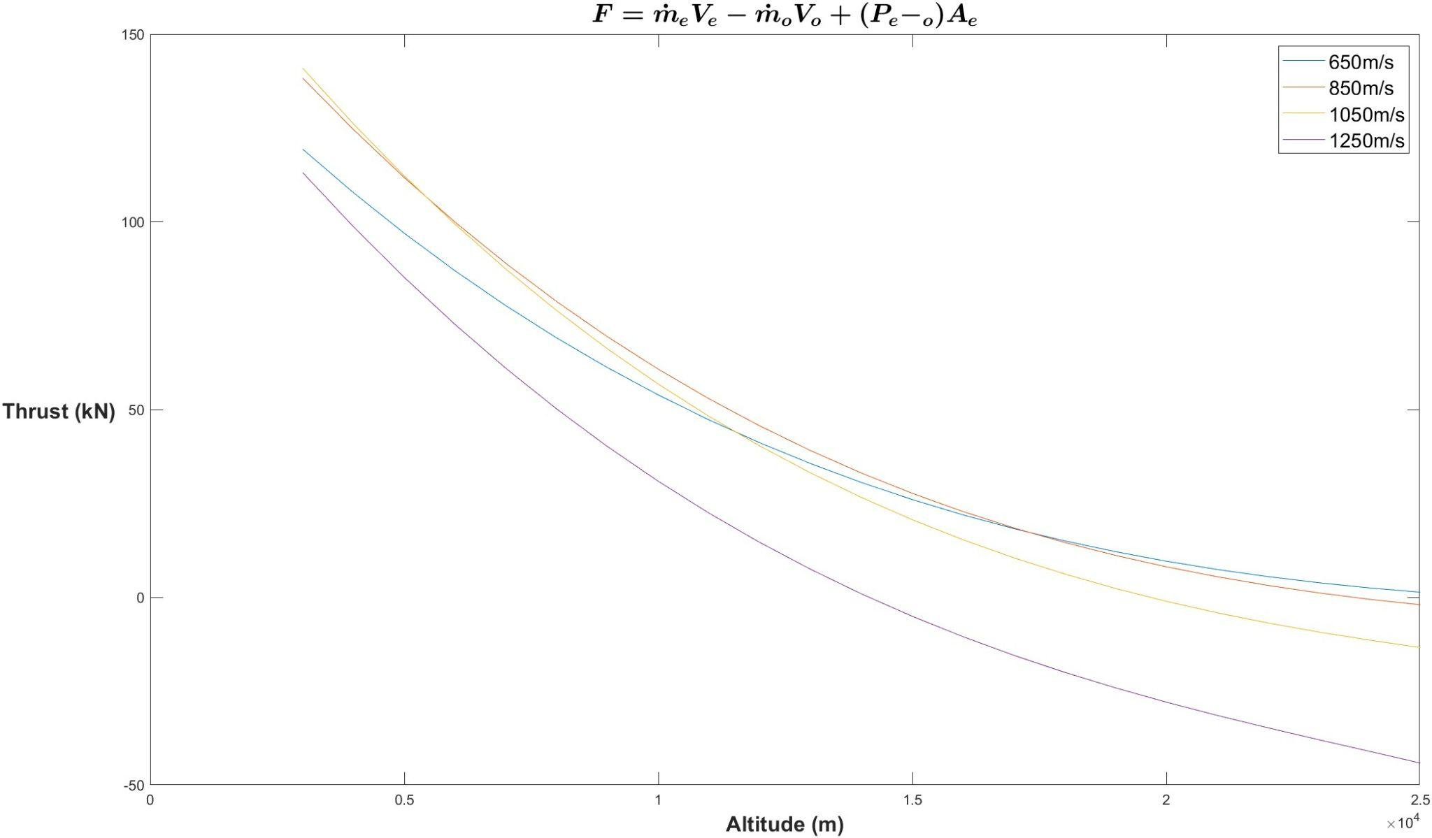
Data Aggregation

Slide 14
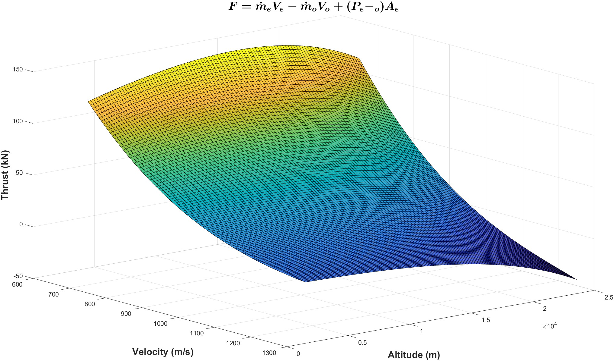
Data Aggregation

Slide 15
Key Points
Performance Factors: Ramjet depends on altitude and speed, optimized for efficiency, thrust, and mass flow.
Ram Effect: Uses shockwave compression instead of a compressor.
Objectives: Analyze Brayton cycle, calculate thrust (NASA/MATLAB/Textbook), and optimize speed/altitude.
Baseline: Operates at Mach 2–4 without boosters; dimensions include a 0.1 m² inlet, 0.01 m² outlet, AFR of 14, and JP-7 fuel.

Slide 16

Thank You
Any Questions?

